Slide 1


Slide 2

TODAY’S PRESENTATION
Overview of what constitutes the GOOD, the BAD and the UGLY when it comes to working with National Service Providers (NSPs).
Discussion on the FACTS about working with NSPs and Regional Providers and current TRENDS.
Learn TIPS (the Do’s and Don’ts) when working with NSPs.

Slide 3

WORKING WITH NSP THE GOOD for CLIENT
• Streamlines internal Accounts Payable process and the number of checks to write.

Slide 4
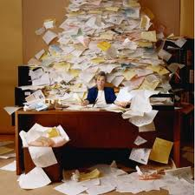
WORKING WITH NSP THE GOOD for CLIENT
• Streamlines Regional Manager involvement allowing more time to work on the company process. Instead of this:

Slide 5
WORKING WITH NSP THE GOOD for CLIENT
Allows for the use of Regional or National foot print leveraging.
→ The more sites to one vendor the better the pricing from that vendor.

Slide 6
WORKING WITH NSP THE GOOD for CLIENT
They are playing follow the leader… as more companies go regional or national more will follow.
Good for client because they reduce their overall cost and they learn from others.

Slide 7

WORKING WITH NSP THE GOOD for CONTRACTOR
The following section outlines what the good SHOULD BE for the Contractor!

Slide 8

WORKING WITH NSP THE GOOD for CONTRACTOR
• Access to accounts you cannot get on their own.

Slide 9

WORKING WITH NSP THE GOOD for CONTRACTOR
• Working in a team environment.

Slide 10
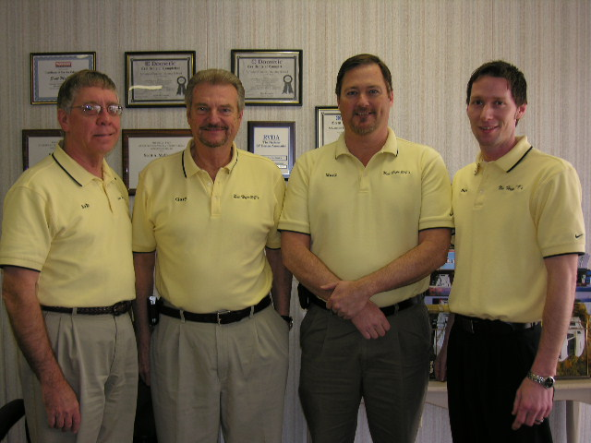
WORKING WITH NSP THE GOOD for CONTRACTOR
• No need for sales staff to work this type of account.

Slide 11

WORKING WITH NSP THE GOOD for CONTRACTOR
• No need for account managers as the Management Company handles this responsibility.

Slide 12

WORKING WITH NSP THE GOOD for CONTRACTOR
• Mostly seasonal work so budgeting is easier.

Slide 13

WORKING WITH NSP THE GOOD for CONTRACTOR
• Training is available for free.

Slide 14
WORKING WITH NSP THE GOOD for CONTRACTOR
• Systems are available for free.

Slide 15

WORKING WITH NSP THE GOOD for CONTRACTOR
• Mentor available.

Slide 16
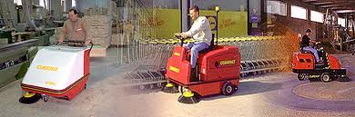

WORKING WITH NSP THE GOOD for CONTRACTOR
• Buying leverage of a large group for equipment and materials.

Slide 17

WORKING WITH NSP THE GOOD for CONTRACTOR
• True win/win relationship.

Slide 18

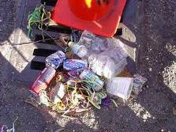
WORKING WITH NSP THE BAD for CLIENT
Low pricing requires more oversight or properties begin to deteriorate.

Slide 19

WORKING WITH NSP THE BAD for CLIENT
Expensive portion of specs are not being followed.

Slide 20
WORKING WITH NSP THE BAD for CLIENT
Lack of control by site level team.

Slide 21

WORKING WITH NSP THE BAD for CLIENT
All out of scope work is greatly overpriced.

Slide 22

WORKING WITH NSP THE BAD for CONTRACTOR
Good contractors cannot perform at this price level.
PRICE PERFORMANCE

Slide 23

WORKING WITH NSP THE BAD for CONTRACTOR
The lower the price the more paperwork required.

Slide 24
WORKING WITH NSP THE BAD for CONTRACTOR
Lower level contractors enter the market.
Lack of response from Management Company.

Slide 25

WORKING WITH NSP THE BAD for CONTRACTOR
Liability pushed to contractor.

Slide 26
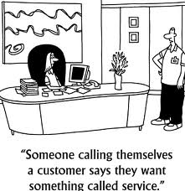
WORKING WITH NSP THE BAD for CONTRACTOR
Unsatisfied customers.

Slide 27
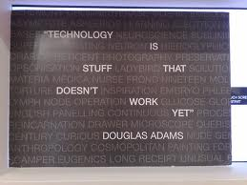
WORKING WITH NSP THE BAD for CONTRACTOR
Technology driven systems that contractors can’t use.

Slide 28

WORKING WITH NSP THE BAD for CONTRACTOR
No way to win.

Slide 29
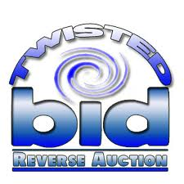
WORKING WITH NSP THE UGLY for CLIENT
Reverse auction drives price below specifications threshold.

Slide 30


WORKING WITH NSP THE UGLY for CLIENT
BIG cost SAVINGS are offset by BIG DISAPPOINTMENTS.

Slide 31

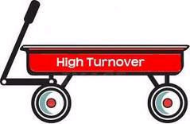
WORKING WITH NSP THE UGLY for CLIENT
High turnover of contractors occurs at the site.

Slide 32
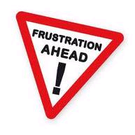
WORKING WITH NSP THE UGLY for CLIENT
High site level frustration.

Slide 33
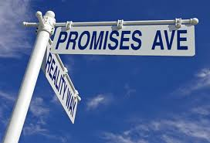
WORKING WITH NSP THE UGLY for CLIENT
Very high result of over promise under deliver.

Slide 34

WORKING WITH NSP THE UGLY for CLIENT
Normally three or more tiers to contractor resulting in poor performance.

Slide 35

WORKING WITH NSP THE UGLY for CLIENT
Hard to change due to cost savings.

Slide 36
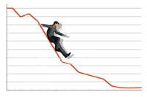
WORKING WITH NSP THE UGLY for CLIENT
Corporate climate continues to push lower.

Slide 37

WORKING WITH NSP THE UGLY for CONTRACTOR
Contractors seem to get pushed around and don’t get paid due to requirements.

Slide 38
WORKING WITH NSP THE UGLY for CONTRACTOR
Absolutely no relationship is possible because people keep changing due to high turnover at the NSP.
Example: The NSP Account Manager who contractor communicates with keeps changing.

Slide 39

WORKING WITH NSP THE UGLY for CONTRACTOR
Unethical management teams.

Slide 40
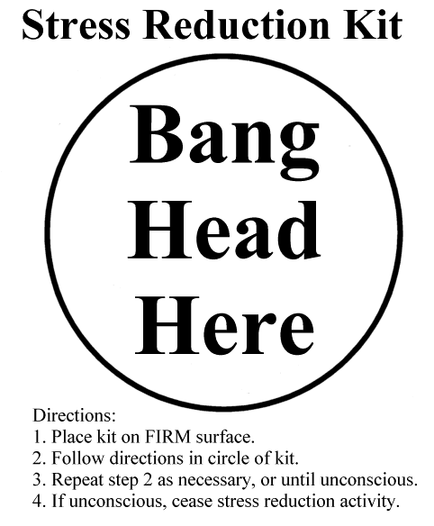
WORKING WITH NSP THE UGLY for CONTRACTOR
Frustration high due to lack of information.

Slide 41

WORKING WITH NSP THE UGLY for CONTRACTOR
Very high reporting requirement.

Slide 42
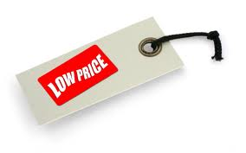
WORKING WITH NSP THE UGLY for CONTRACTOR
Very low overall price.

Slide 43

WORKING WITH NSP THE UGLY for CONTRACTOR
Signature papers that result in more man hours on account.

Slide 44
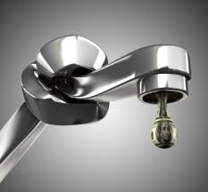
WORKING WITH NSP THE UGLY for CONTRACTOR
Long drawn out pay cycle creating cash flow problems.

Slide 45
WORKING WITH NSP THE UGLY for CONTRACTOR
Contractor can no longer afford to operate.
Most often contractors coming in are coming into a bad relationship with the client.

Slide 46
WORKING WITH NSP THE FACTS
National and Regional Management Companies have developed the reputation of using contractors’ need to perform against them.

Slide 47
WORKING WITH NSP THE FACTS
Contractors by nature want to do a good job and these management companies know that.

Slide 48
WORKING WITH NSP THE FACTS
Just like in your own market, remember that there are more bad companies than good ones.
→The same holds true for management companies.
→There are good ones out there, you just have to find them.

Slide 49
WORKING WITH NSP THE FACTS
One reason ‘THE UGLY’ happens is because we as contractors keep saying ‘yes’ thinking we can change it later.

Slide 50
WORKING WITH NSP THE FACTS
As pricing is being driven down, it is not likely to go up any time soon.
→ This trend will continue for a long time.

Slide 51

WORKING WITH NSP CONTRACTOR “DO” LIST
Negotiate everything you are uncomfortable with (including pricing).

Slide 52

WORKING WITH NSP CONTRACTOR “DO” LIST
Gain a full understanding of the reporting requirements prior to taking on the work.
Gain a full understanding of the liability and risk you will be assuming.

Slide 53
WORKING WITH NSP CONTRACTOR “DO” LIST
Ask for references of contractors they still have working for them and at least two (2) who no longer work for them.

Slide 54

WORKING WITH NSP CONTRACTOR “DO” LIST
Research the company on the internet, check out chat rooms to see what others are saying.

Slide 55
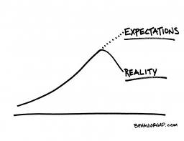
WORKING WITH NSP CONTRACTOR “DO” LIST
Meet with the on site team from the NSP to discuss specs versus level of expectation.

Slide 56
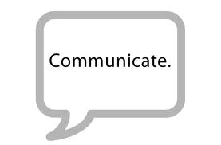
WORKING WITH NSP CONTRACTOR “DO” LIST
Discuss level of expectation with the client you will be servicing.
Talk to the Vendor management team at the NSP before starting the contract.

Slide 57

WORKING WITH NSP CONTRACTOR “DON’T” LIST
If you don’t agree with the terms of the contract, then DON’T sign it.
Don’t just sign the contract to get the work.

Slide 58

WORKING WITH NSP CONTRACTOR “DON’T” LIST
Don’t accept anything verbally, make NSP put it in writing or in an email.

Slide 59
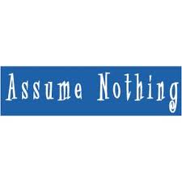
WORKING WITH NSP CONTRACTOR “DON’T” LIST
Don’t get sold by the account manager with promises of more work.
Don’t assume that you will get paid just because you did the work.

Slide 60

WORKING WITH NSP CONTRACTOR “DON’T” LIST
Don’t just talk to one person at the NSP or RSP, make sure you talk to three (3) or more individuals from the company.

Slide 61

Questions & Answers

